Slide 1





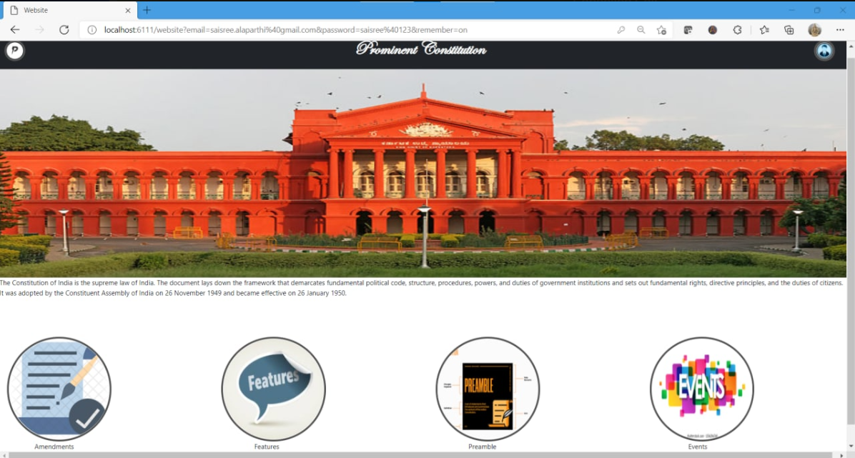
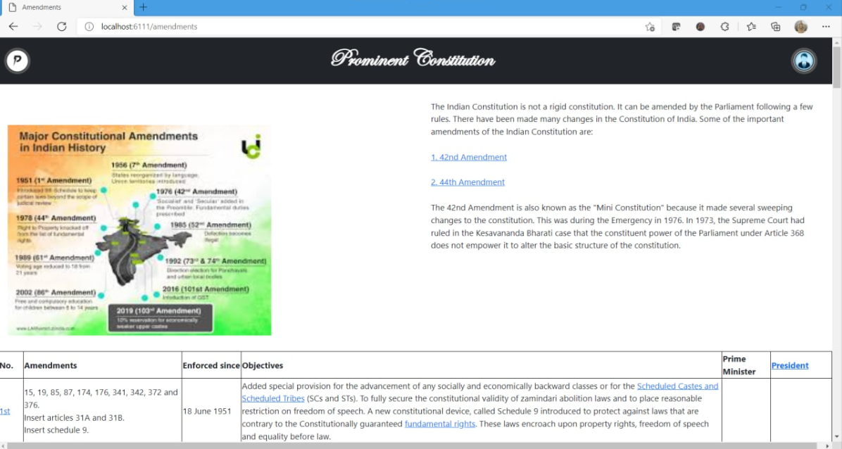



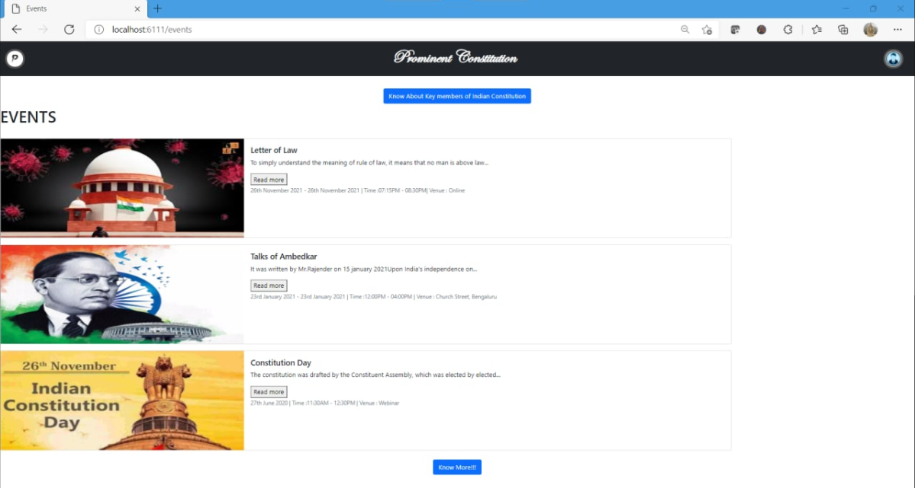
Prominent Constitution
190030944 -LINGAMAGUNTA NAGA VEENA,190030045 - ALAPARTHI SAI SREE,190030351-SAHITHYA DACHEPALLI
Harika Lakshmi Mam
Department of CSE, KLEF
Introduction
Block Diagram
Output Screenshots
Objective
To create awareness about the constitutional values and objectives written in the Indian Constitution.
To ascertain the views of student teachers regarding the achievement made in respect of each of the values /objectives in the present context in India.
Problem Statement
The Constitution of India is the supreme law of India. The document lays down the framework that demarcates fundamental political code, structure, procedures, powers, and duties of government institutions and sets out fundamental rights, directive principles, and the duties of citizens.
Proposed Solution
Firstly we want to conduct a survey about how many people of our country about fundamental rights they have or at least know preamble of Indian Constitution. Making people to know about the significance of the Constitution to it’s citizens.
We have to make people know about
fundamental rights,
What distinguishes a Constitution from Laws Made by the Legislature,
How can a constitution protect individuals’ rights,
How do the Government and Courts Function etc
Modules
Conclusion
Advantages
Indian constitution has detail procedures to follow to carry out any legislative, executive and judiciary activities due to which it provides lots of transparency in the system. Indian constitution has bestowed Indians with fundamental rights and doesn't matter what the case it, fundamental rights prevails

